Slide 1
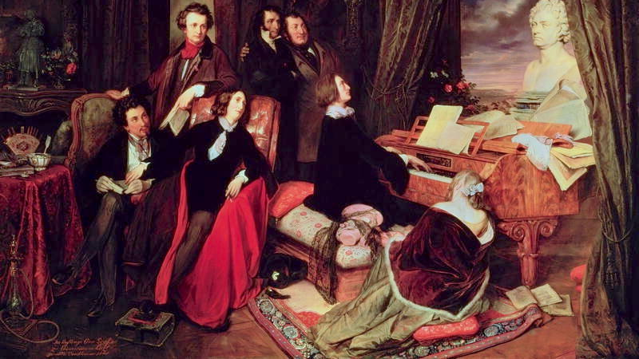
Conjugal Fidelity
Liszt, Transcription, and Gender

Slide 2


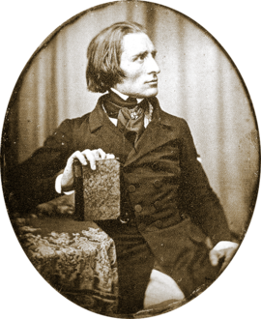


Slide 3
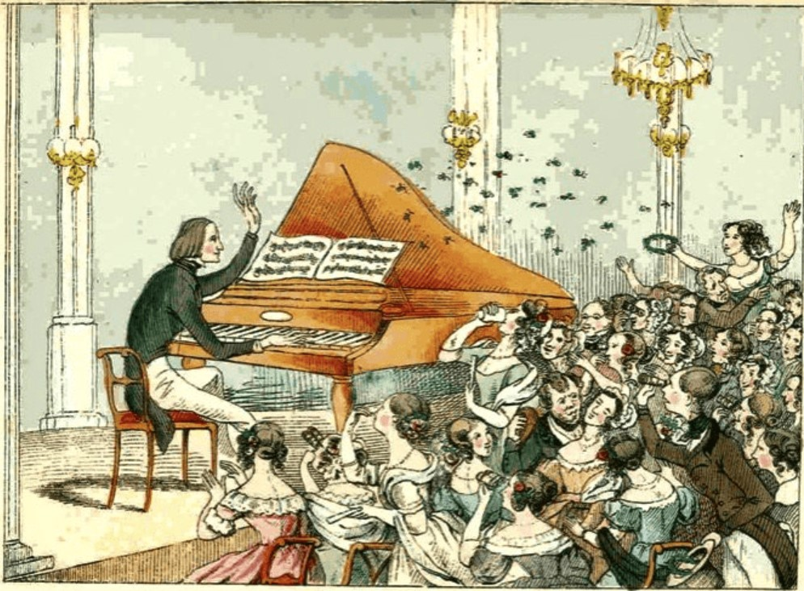
Lisztomania
‘… Liszt once threw away an old cigar stump in the street under the watchful eyes of an infatuated lady-in-waiting, who reverently picked the offensive weed out of the gutter, had it encased in a locket and surrounded with the monogram F.L. in diamonds…’ (Walker 1987, 371)

Slide 4
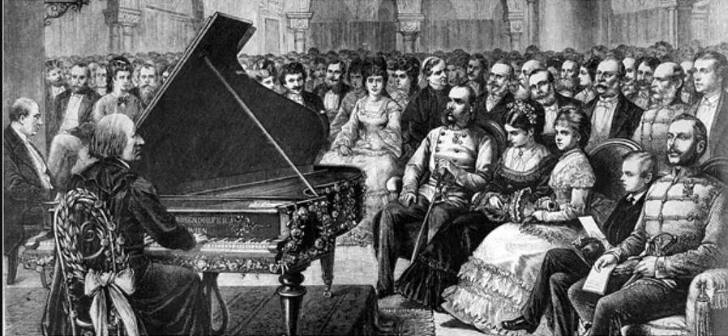
‘Gender is… a set of repeated acts within a highly rigid regulatory frame that congeal over time to produce the appearance of… a sort of being.’ (Butler 1999, 43-44)

Slide 5
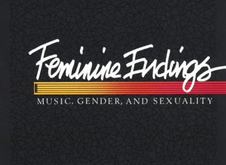

Literature Review
McClary, Susan. Feminine Endings: Music, Gender, and Sexuality. Minneapolis: University of Minnesota Press, 1991
Walker, Alan. Franz Liszt. Vols. 1-3, London: Faber, 1983.
Ellis, Katharine. "Female Pianists and Their Male Critics in Nineteenth-Century Paris." Journal of the American Musicological Society 50, no. 2-3 (1997): 353-85.
Raykoff, Ivan. "Transcription, Transgression, and the Procreative Urge." In Queer Episodes in Music and Modern Identity, edited by Sophie Fuller and Lloyd Whitesell, 150-76. Urbana: University of Illinois Press, 2002.
Leppert, Richard. "Cultural Contradiction, Idolatry, and the Piano Virtuoso: Franz Liszt." In Piano Roles: A New History of the Piano, edited by James Parakilas, 252-81. Yale: Nota Bene, 2008.

Slide 6
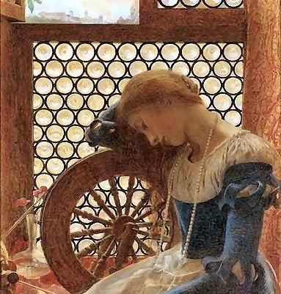
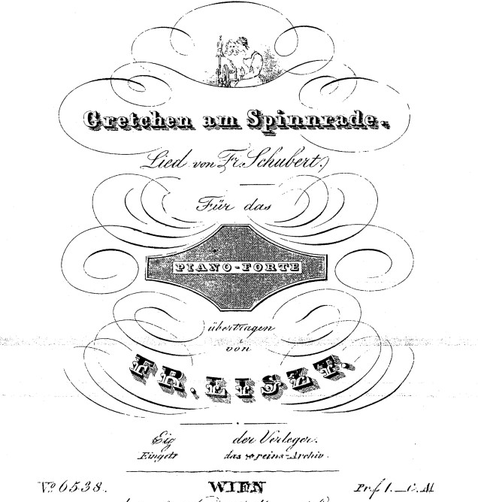
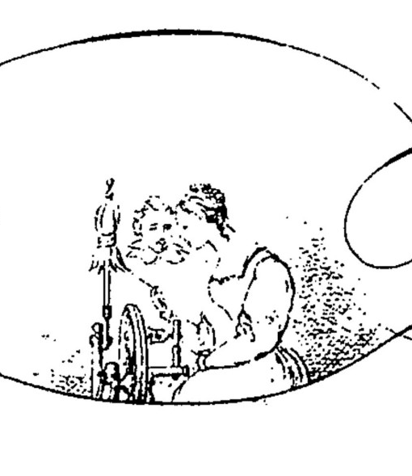

Slide 7
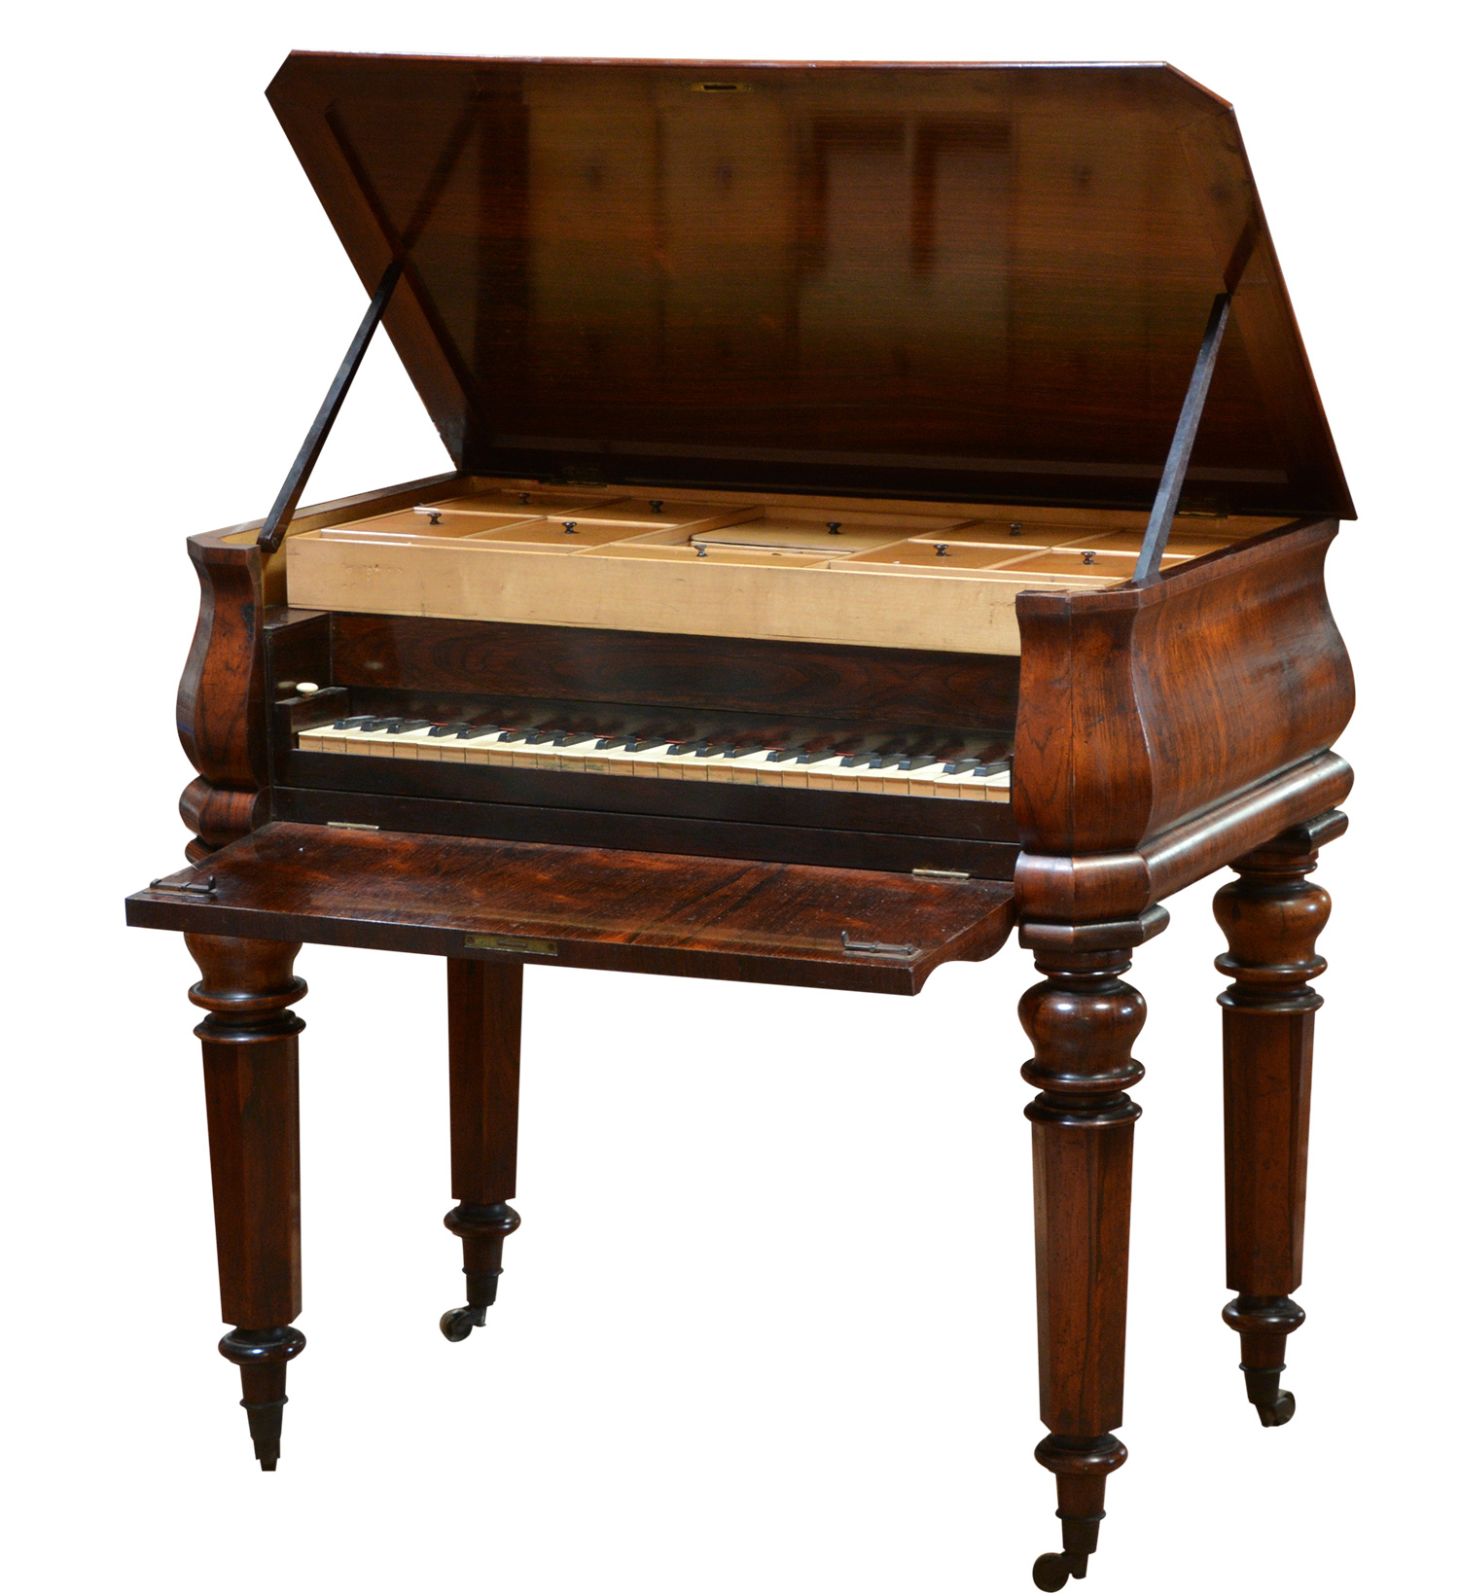
Gretchen am Spinnrade
… Während deren hin und Herbrausen in meinen zerstükten kopf (ich vergeße nicht, das Gretchen, verükten kopf und zerstükten sinn sagt)
[… while they roar back and forth in my broken head (I don’t forget what Gretchen says, broken head and broken mind)]
- Liszt in a letter to Emilie Genast, 1860.

Slide 8
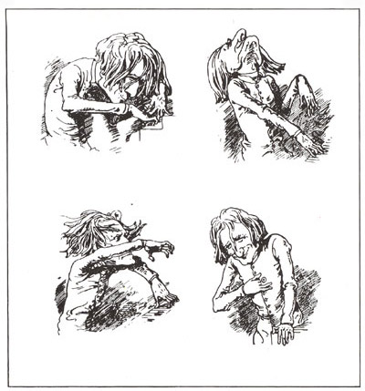
Gretchen am Spinnrade
‘I saw Liszt’s countenance assume that agony of expression, mingled with radiant smiles of joy, which I never saw in any other human face, except in the paintings of our Saviour… [when suddenly] the hand and frame of the artist gave way; he fainted in the arms of the friend who was turning over [the pages] for him, and we bore him out in a strong fit of hysterics…’ Henry Reeve, 1835.

Slide 9
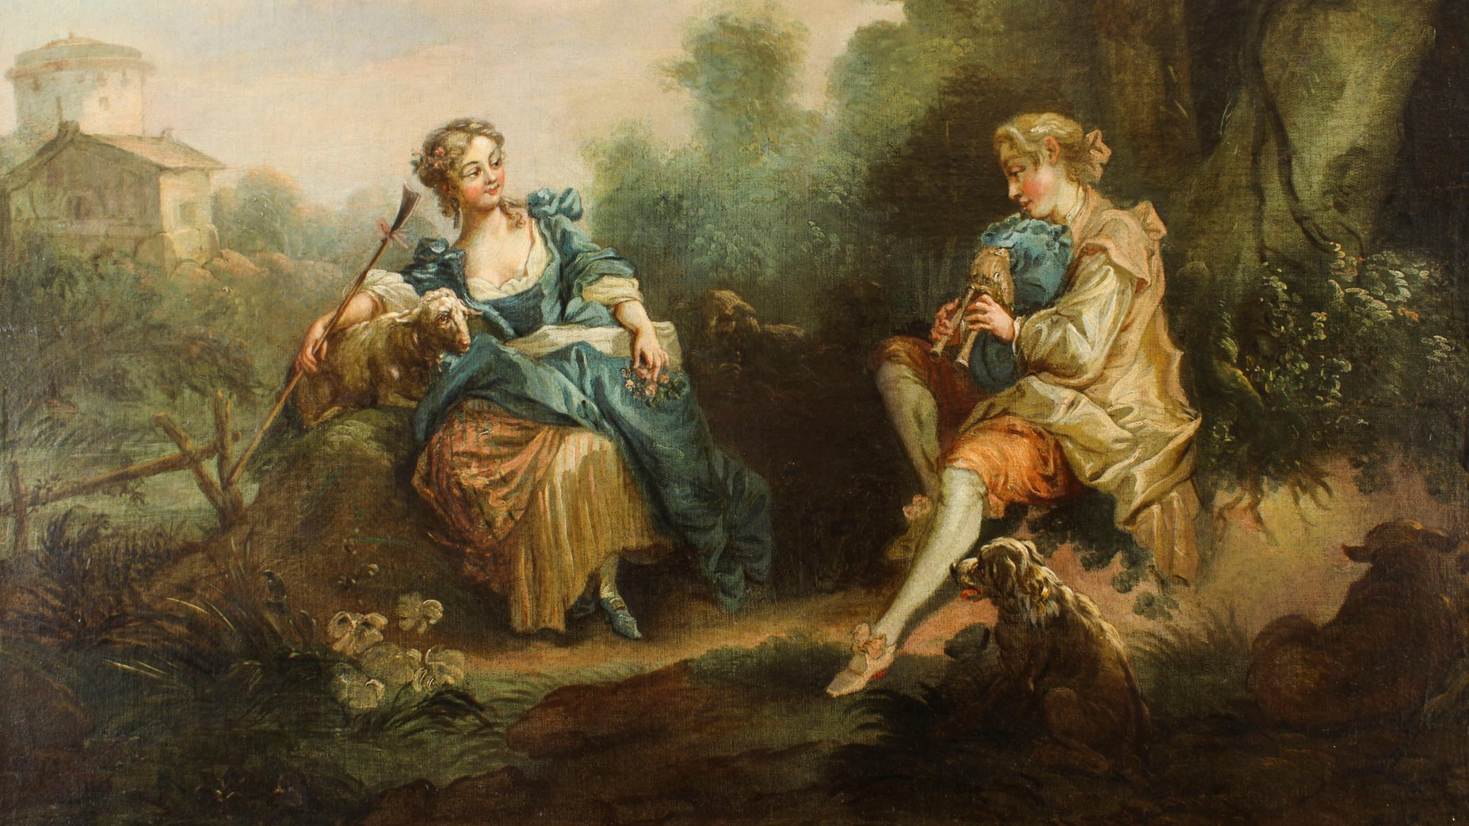

Slide 10
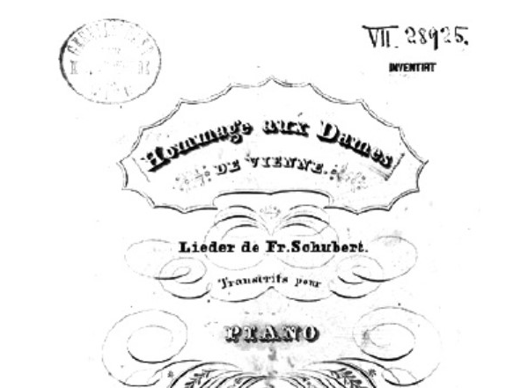
Ständchen
‘However the repertory is gendered, piano transcriptions can destabilise received categories and relations by altering the grounds of production and reception’ (Christensen 1995, 285)

Slide 11
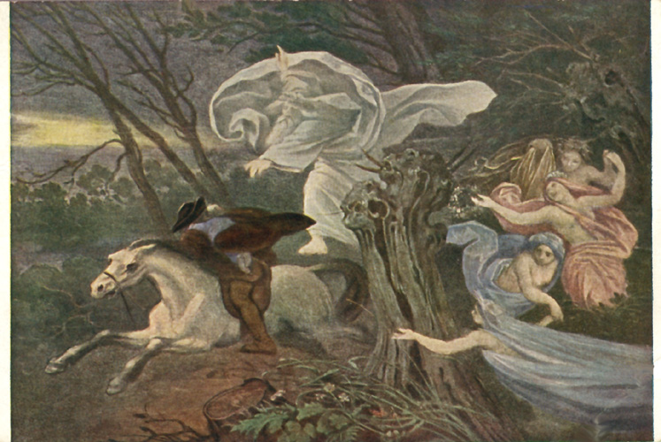
Erlkönig
‘Schubert failed to capture the bitter simplicity of the poem… [he] made out of the trees of the German woods a fragrant orange grove, and adorned the northern phantom with all the charms of seductive sensuality…’ Max Friedlander, 1889.
‘Sung by a woman, the song is both a lament and accusation. It relentlessly exposes the father’s failure– the failure of traditional paternity– to nurture, to sympathise…’ (Kramer 2017, 7)

Slide 12
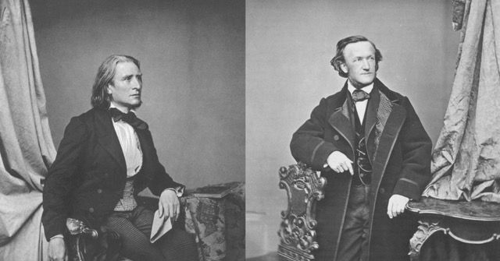
'In transcription, there is no need for too much invention: a certain conjugal fidelity to the original is usually best.’ Franz Liszt, 1880

Slide 13
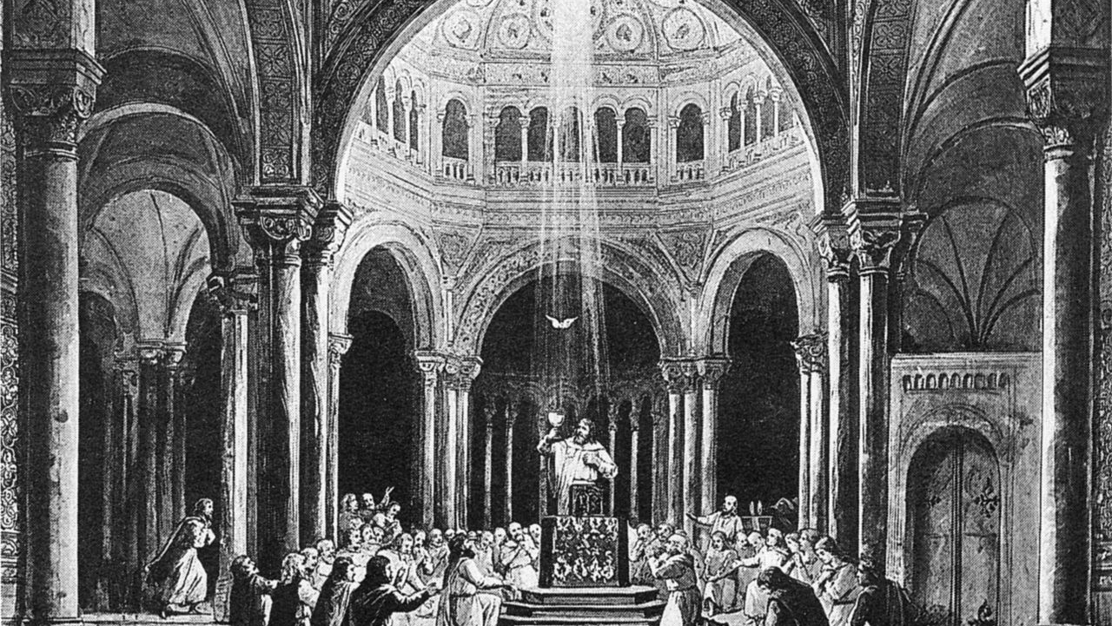
‘Liszt needs women in his life just as he needs a varied tone colour in his orchestra…’ Carolyne von Wittgenstein, 1873

Slide 14
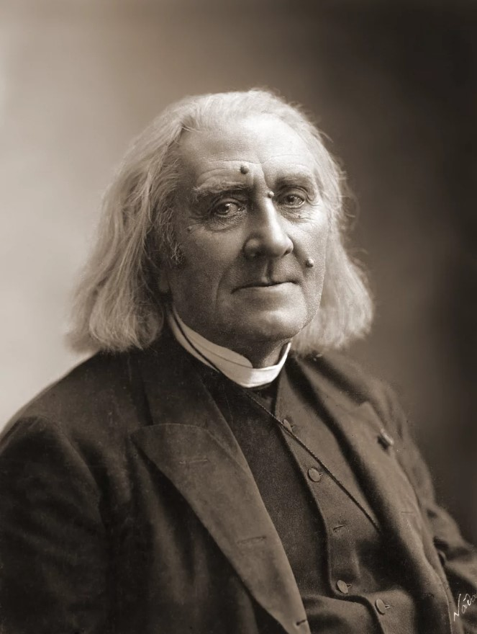
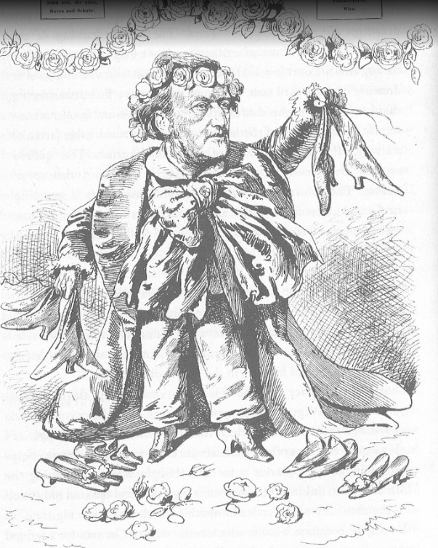

Slide 15
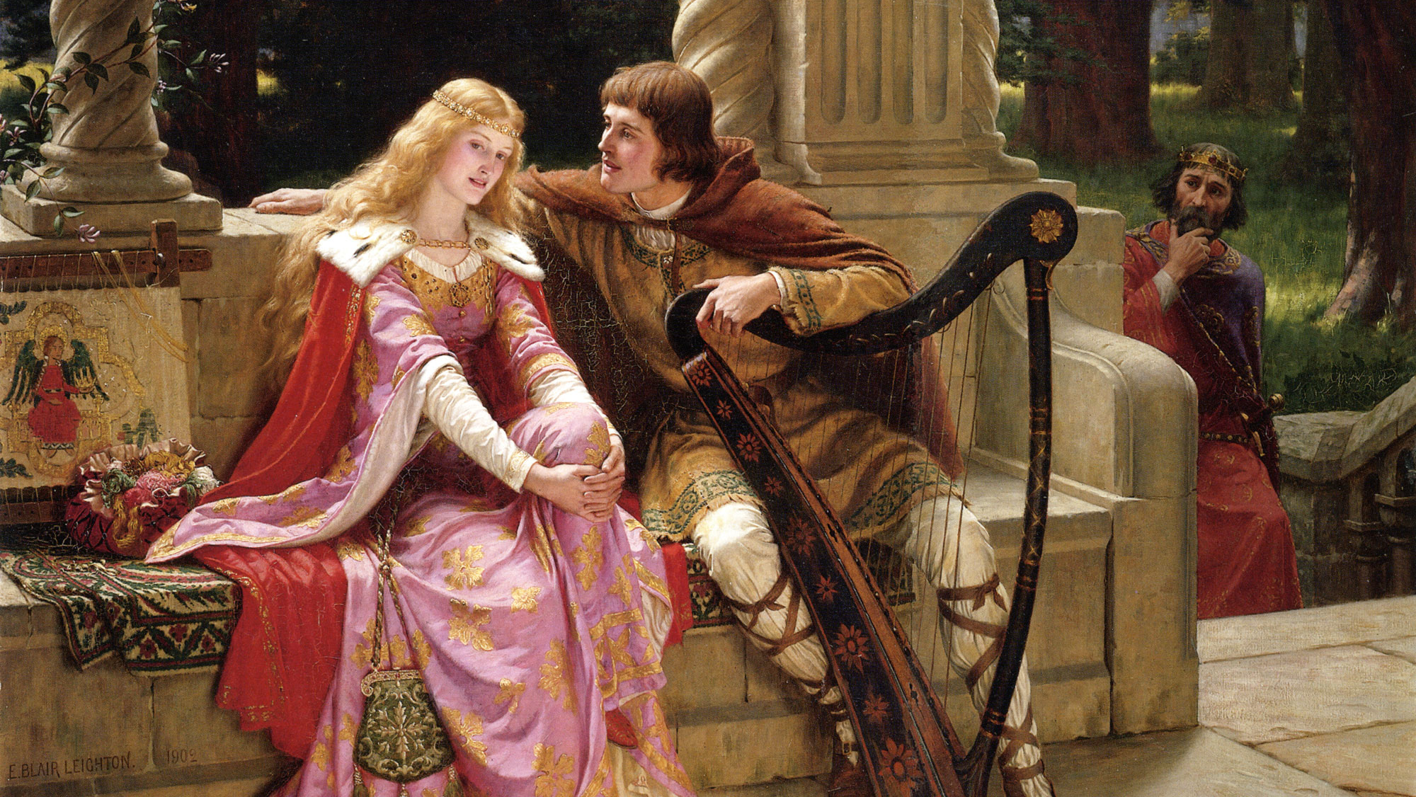
‘Tristan und Isolde… was the most repulsive thing I have ever heard in my life… [it was a] sexual frenzy…’ Clara Schuman, 1875.
‘I often experienced a feeling of a rather bizarre kind, the pride and pleasure of understanding, of letting myself be penetrated, invaded, a truly sensual voluptuousness, which resembles that of ascending into the atmosphere or riding the waves… Monsieur, I thank you.’ Charles Baudelaire to Wagner, 1860.

Slide 16
